Slide 1
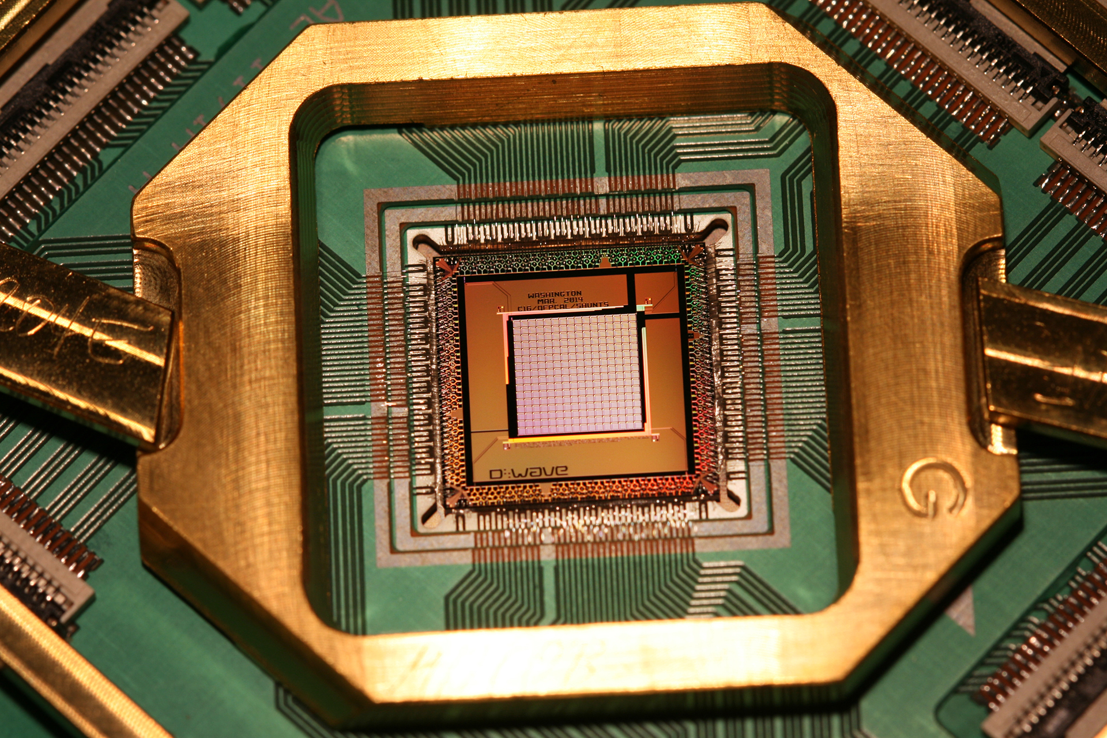
Quantum Computing
Studies theoretical computation systems
Use of quantum-mechanical phenomena
Superposition and entanglement
Perform operations on data

Slide 2


Quantum Computing
Able to solve certain problems much more quickly
Shor’s algorithm
Simulation of quantum many-body systems
Simon’s algorithm etc.

Slide 3
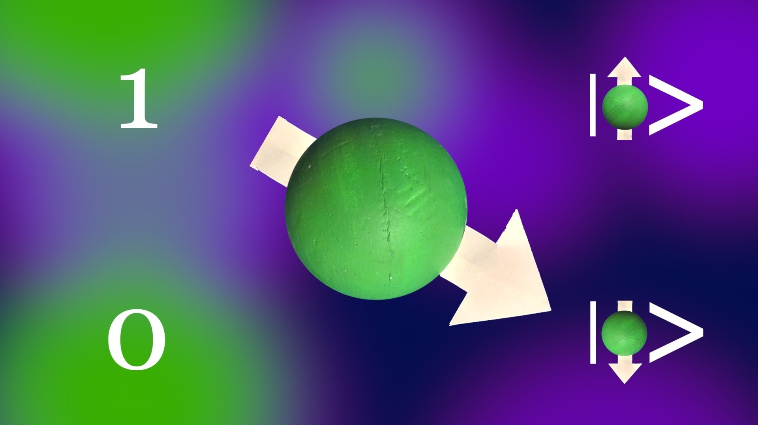
Quantum Computing
Qbits
A single qbit can represent a “0” and “1” at the same time
Super computing power

Slide 4

Shor’s Algorithm
Runs polynomial time on a quantum computer
Factoring becomes easy

Slide 5

RSA Encryption Fails
If there are sufficient Qbits, Shor’s algorithm could be used to break public-key cryptography
RSA scheme fails.
Assumption on intractable large number computation
However, efficient on an ideal quantum computer

